Slide 1
Architecting E-Commerce Solutions with .NET & Azure Cloud
Rajneesh Hajela
18+ years,
.NET Azure Solution Architect

Slide 2
Strategy
Governance
Architecture framework
Business Alignment
cost optimization, security, scalability, governance, and compliance.

Slide 3
Objectives of the workshop
Introduction to E-Commerce Architecture: A brief overview of modern e-commerce platform needs.
Deep Dive into .NET Core and Microservices: How to structure an e-commerce platform with .NET Core using microservices architecture.
Leveraging Azure Cloud Services: Discuss Azure services like AKS (Azure Kubernetes Service), Cosmos DB, Azure Functions, APIM (API Management), Azure App Services, and Azure Logic Apps.
AI-Driven Solutions for E-Commerce: Using Azure AI to personalize customer experiences, automate product recommendations, and optimize business processes.
Cost Optimization with Azure: Highlight how Azure’s pay-as-you-go model and services like Azure DevOps and Azure Automation help lower infrastructure and operational costs.

Slide 4
Introduction to E-Commerce Architecture:
A brief overview of modern e-commerce platform needs.

Slide 5
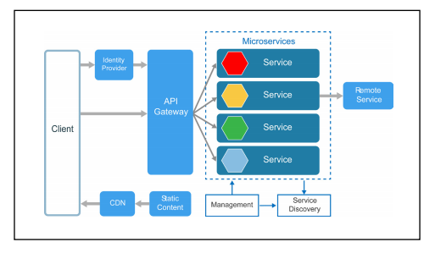
Identity Provider, Angular, Web API(.NET Core) Security, Logging, Monitoring, Scalability, Deployment, Caching, Costing
Security
Compliance
(General Data Protection Regulation)
Logging
Monitoring
Communication
Backup & DR
High Available
Scalable
Reliable
Flexible
Available
MASS Transit
Health Check
Communication
Caching
Blue Green Deployment
RTO RPO
Docker
DevOps CICD Pipeline
Deployment on
App services/ AKS/ VM
Fault Tolerance
SAGA, CQRS, DDD
(Azure ADB2C/Identity Server/ Other..), Entity Framework, Application insight, application Gateway, API Management, AKS, Azure SQL DB, Azure Service Bus, VM, Key Vault, Function, logic app, Cognitive Services etc.
Angular (Component, Directive, Service, Pipe, AuthGuard, http services, MSAL)
Web API (Secure API, Role based Authorization, logging, Communication etc)

Slide 6
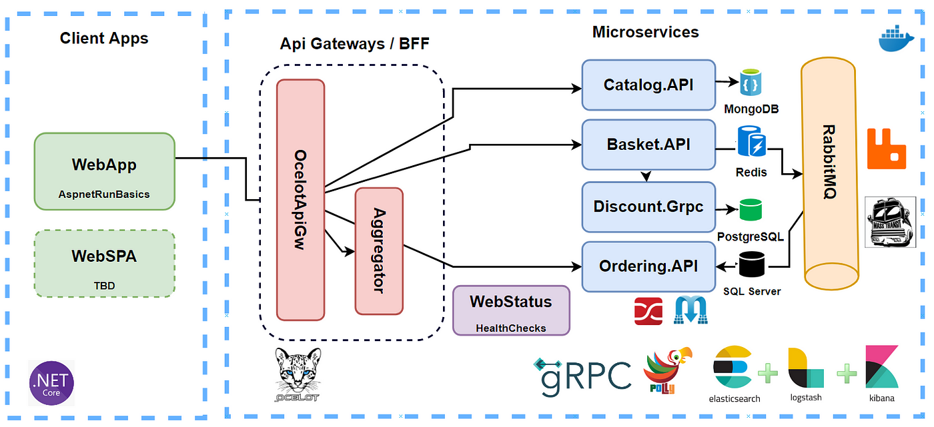
High available & Scalable architecture Microservices Architecture
12 Factor Microservice Rule
Authentication and Authorization, Encryption ( IdentityServer, OAuth 2.0, JWT), SSL/TLS
API Gateway(Ocelot, Azure API Management)
Logging and Monitoring (ELK Stack (Elasticsearch, Logstash, Kibana)/ New Relic, Azure application Insight, log Analytics
Service Discovery (Consule, Kubernetes Services)
Fault Tolerance(Circuit Breakers-Polly, retries, timeouts)
Database Scaling (sharding, replication)
Load Balancing-Kubernetes Ingress Controllers, Azure load balancer
Distributed Tracing(Application Insights, OpenTelemetry)
Autoscaling (Kubernetes Horizontal Pod Auto scaler (HPA)
Microservices Communication- RESTful APIs, gRPC, Messaging Queues (RabbitMQ, Kafka)
Health Checks - Kubernetes Probes, ASP.NET Core Health Checks, Consul Health Checks
Containerization(Docker, Docker Swarm),Orchestration – Kubernetes
Continuous Integration/Continuous DeploymentCI/CD) -Jenkins, Github, Azure DevOps
Infrastructure as Code (IaC) – Terraform, ARM Template, Bicep
Async, Middleware, SonarQube, Resharper. Code Analysis, Branching Strategy

Slide 7
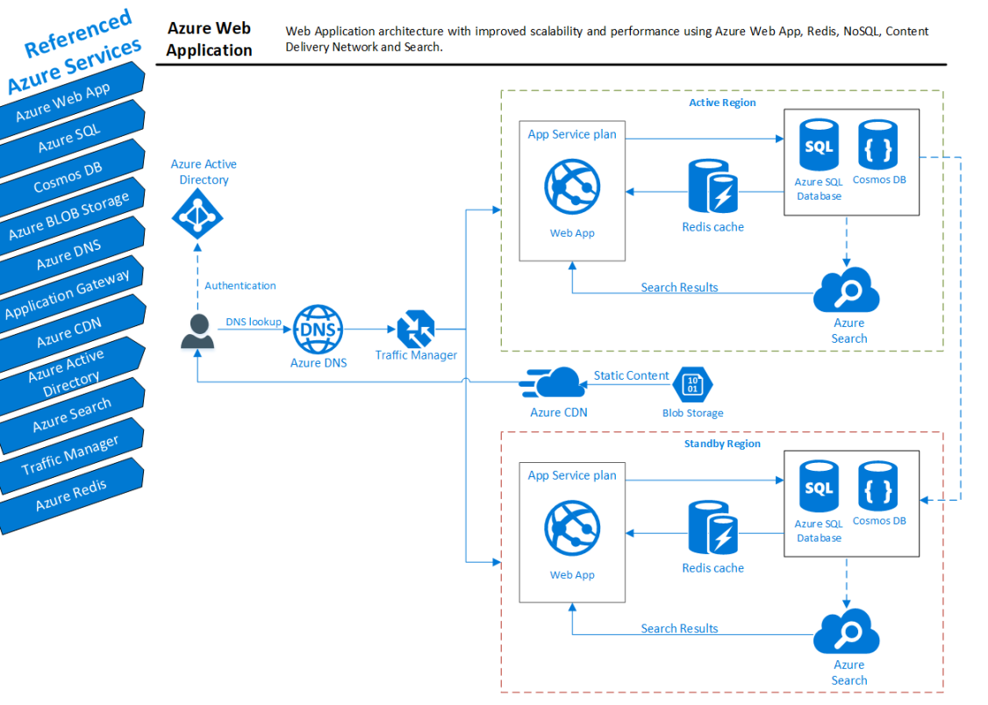

Slide 8
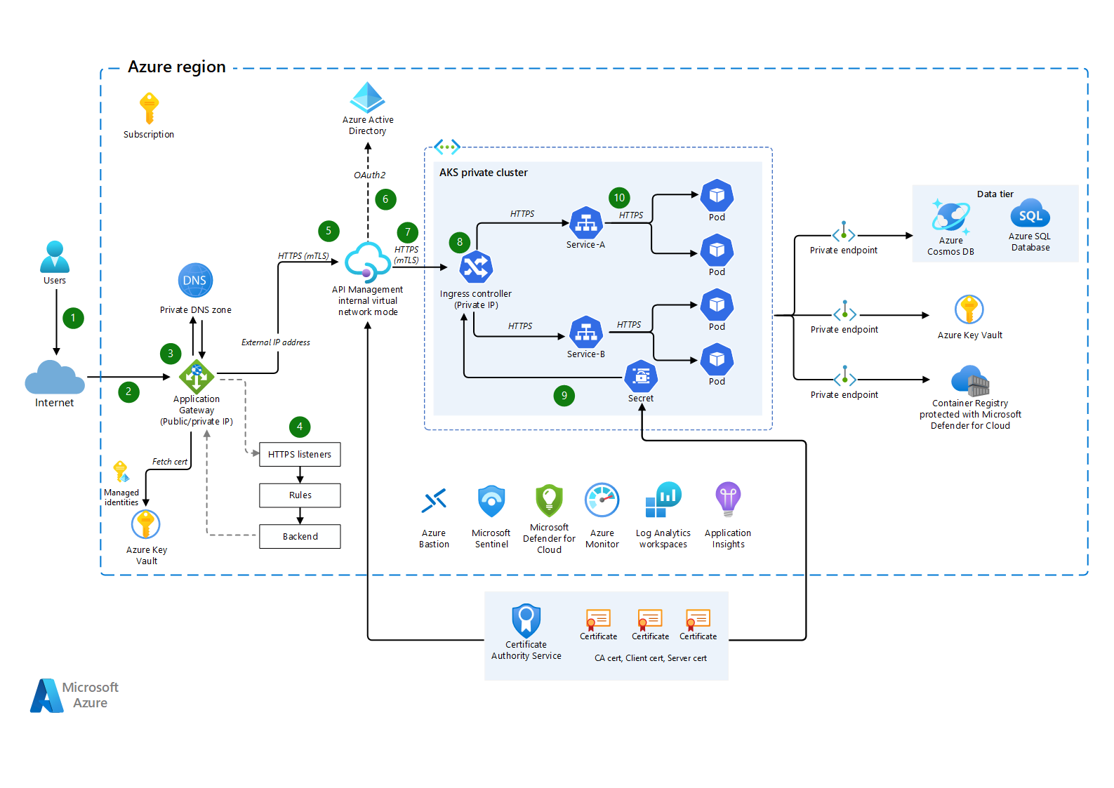
Azure API Management

Slide 9


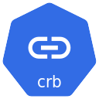


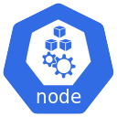


Azure Active Directory & Kubernetes RBAC
Authentication
k8s Cluster Role
Azure AKS Kubernetes Cluster
Cluster Role Binding
k8s Cluster Role Binding
Azure Active Directory
Cluster Role
Integrate Azure AD Group & Kubernetes RBAC
User / Group
(Subject)
Get
(Verb)
Azure AD Group: aksreadonly
Access
Granted
(Resources)
Object ID: e6dcdae4-e9ff-42
61-81e6-0d08537c4cf8
4
3
Credentials Cached
kubectl get nodes
1
2
Read Only User
Terminal
Azure AD User: aksread1
Your Desktop

Slide 10
1. Scalability
Azure Autoscaling
Azure Front Door
Load Balancer
Handling flash sales & high traffic spikes
Azure AKS (Scale Up & Down)

Slide 11
2. Security
Authentication & Authorization: Azure AD B2C, OAuth 2.0, APIM, WAF
Identity Management: Azure AD B2C, Identity Server 4, App Registration, JWT, OAuth, OpenID, HTTPs, gRPC, OWIN
Key Vault & Secrets Management: System & Managed Identity, Access Policy, Soft Delete, Purge Protection
API Security: Fraud Detection, API Gateway (Ocelot, APIM), API Key Management

Slide 12
3. Flexibility & Reliability
Design Patterns: GOF, Clean Architecture, DDD, CQRS, Retry & Circuit Breaker (Polly)
Integration & Messaging: Ocelot API Gateway, APIM, Event Grid, Event Hub, Service Bus, ESB, RabbitMQ, Kafka
Fault Tolerance: Throttling, Threading
Backup & Disaster Recovery: Code Backup, DB Backup, VM Backup, RTO, RPO
Elasticity: CPU, Memory, Storage, App Service Plan, VMSS, Elastic Pool (DB)

Slide 13
4. Logging & Monitoring
Tools: ElasticSearch, Logstash, Kibana, Azure Log Analytics, Azure Application Insights, Azure Monitor
Distributed Tracing: Correlation ID, Telemetry
5. Caching & Performance
Caching Mechanisms: Redis Cache, CDN, Output, Data, Fragment, Donut, In-Memory
Latency Optimization: CDN, Caching (Redis), CQRS, Azure Service Bus
Performance Testing: API Health Checks, Monitoring, Alerts

Slide 14
6. API Management
API Versioning & Revision
Async Communication & Transactions
API IP Address Management
API Testing (Unit Testing, Code Coverage, Resharper)
7. Deployment & DevOps
CI/CD Pipelines: Azure DevOps, Terraform, ARM Templates
Deployment Strategies: Blue-Green Deployment, Canary Releases, One-Click Deployment
Secure DevOps: Secrets in Azure Key Vault, Infrastructure as Code (IaC)
Multi-region Deployment: Availability Set, Availability Zone
Azure Resource Management: Subscription, Resource Group, Tenant

Slide 15
8. Azure Services & Architecture
Compute & Serverless: Azure App Services, Azure Functions, Azure Logic Apps, Azure API Management
Data & Storage: Azure SQL Database, Azure Cosmos DB (Eventual Consistency, Strong Consistency)
Messaging & Event-Driven Architecture: Event Sourcing, SAGA Pattern, Outbox Pattern, Azure Event Grid, Event Hub, Service Bus, RabbitMQ, Kafka
Load Balancing: Azure Application Gateway, Load Balancer, Traffic Manager, WAF
Three-Tier Architecture: Hub-Spoke Model

Slide 16
9. Identity & Access Management
Azure AD B2C: Tenant Creation, User Flow (Sign-Up, Sign-In, Password Reset)
App Registration: Identity Provider Configuration, API Permissions, JWT Token Handling
Graph API Integration: Authentication across multiple APIs
10. AI & Automation
AI Services: Cognitive Services, AI Search, Vision API, Azure OpenAI, AI Bot Services
Automation & Scheduling: Azure Logic Apps, Scheduled Batch Jobs, DevOps CICD Pipeline

Slide 17
11. Development & Testing
Unit Testing Frameworks: MOQ, NUnit, xUnit
Rest API Testing: Postman, Swagger, Resharper
Git & Version Control: Git, GitLab, GitHub, Git Clone
12. Azure Messaging & Event Handling
Azure Messaging Services: Event Grid, Event Hub, Service Bus
Event-Driven Architecture: CQRS, Event Sourcing, Integration with Messaging Systems
Serverless Functions: Azure Functions for event processing

Slide 19
Logging & Monitoring, Healthcheck, Alert Messge etc

Slide 20
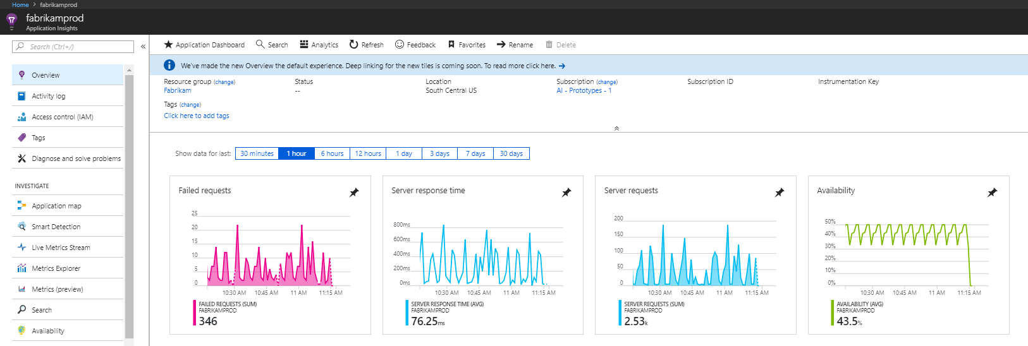
Azure application insight
Application Insights is an extension of Azure Monitor and provides application performance monitoring (APM) features. APM tools are useful to monitor applications from development, through test, and into production in the following ways: Proactively understand how an application is performing.

Slide 21
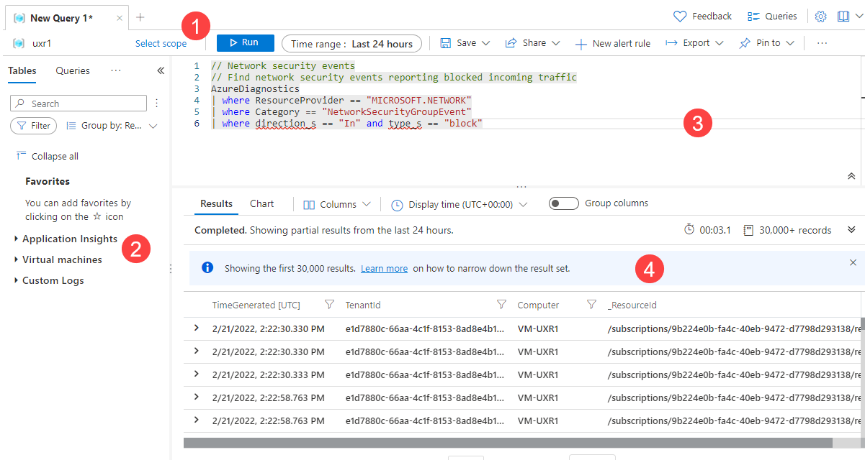
Azure Log Analytics

Slide 22
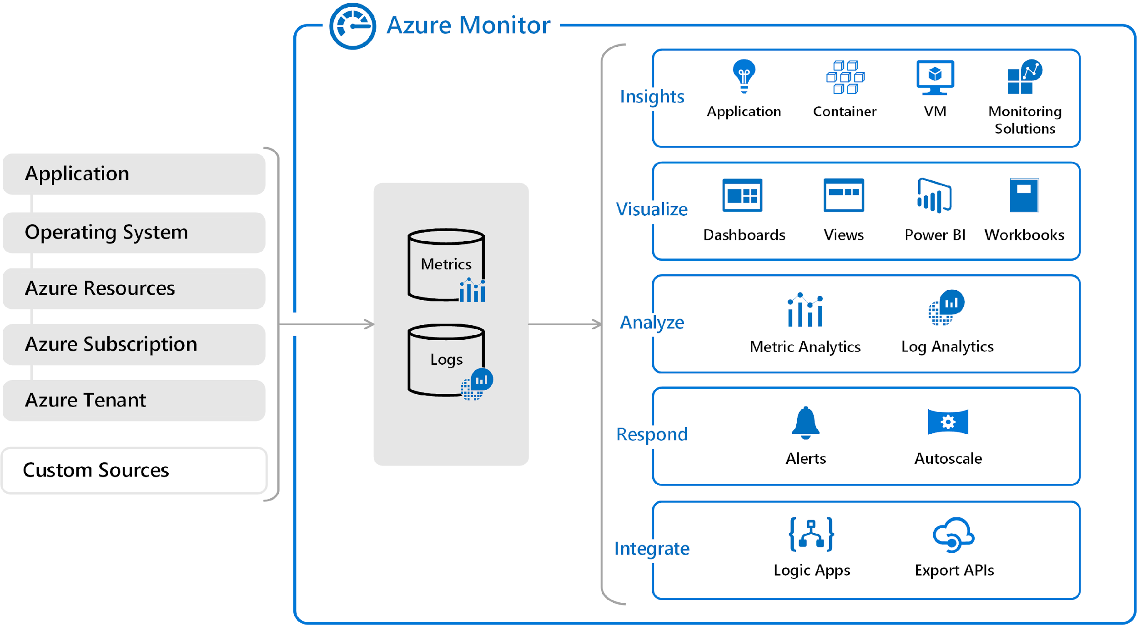

Slide 23
Cost-Benefit Analysis
Key components: User Management, Catalog, Cart, Payment, Order Processing, Inventory
High-level architecture with .NET Core Microservices & Azure
Cloud-native vs. hybrid approaches

Slide 24
Slide 3: Key Challenges in E-Commerce & Resolution
Scalability (Handling flash sales, high traffic spikes)
Azure Autoscaling, Azure Front Door, Load Balancer
Security (Handling fraud detection, API security)
Azure AD B2C, OAuth 2.0, APIM, WAF
High Availability & Resilience
Multi-region deployment, Azure Cosmos DB, Event-driven architecture
Performance & Latency
CDN, Caching (Redis), CQRS, DDD, Azure Service Bus
Data Consistency
Event Sourcing, SAGA Pattern, Outbox Pattern

Slide 25
Slide 4: Solution Architecture - .NET & Azure Cloud
.NET Microservices with Azure
API Gateway (Azure APIM)
Backend Microservices (Order, Payment, Inventory)
Azure SQL, Azure Cosmos DB
Authentication & Authorization
Azure AD B2C, OAuth, JWT tokens
Logging & Monitoring
ELK Stack (Elasticsearch, Logstash, Kibana), Azure Monitor, App Insights

Slide 26
Slide 5: DevOps Strategy for E-Commerce
CI/CD using Azure DevOps
Blue-Green Deployment, Canary Releases
Infrastructure as Code (Terraform, ARM templates)
Secure DevOps practices (Secrets in Azure Key Vault)

Slide 27
Slide 6: Real-world Case Studies & Demo
Case Study of an E-Commerce Platform handling millions of transactions
Live Demo: Deploying a microservice to Azure AKS with API Gateway

Slide 28
Slide 7: Hands-on Challenges & Solutions
Real-world problem-solving session
How to troubleshoot performance bottlenecks
Handling failures in a distributed microservices system
Using Polly for resilience (Retry, Circuit Breaker)

Slide 29
Slide 8: Best Practices & Takeaways
Do’s and Don’ts in architecting e-commerce on .NET & Azure
How to future-proof your architecture
Recommendations on cost optimization & governance

Slide 30
Slide 9: Q&A and Workshop Closure

